Slide 1
CSA 1220 – COMPUTER ARCHITECTURE FOR FUTURE ENGINEERS Title
Evaluating Pipeline Efficiency Through Forwarding Techniques
Guided by
DR. T. KUMARAGURUBARAN DR. S. SENTHILVADIVU
PRESENTED BY
Mohammed Farhan K.F
(192512479)
Sayyad Ibrahim
(192525257)

Slide 2
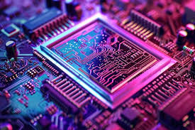
Introduction:
What is Pipelining?
A technique in processor design where instruction execution is overlapped, improving throughput.
The Challenge: Data Hazards.
This happens when one instruction needs info from a previous instruction that's still being worked on and isn't ready yet. It's like trying to use a tool before it's fully built.
The Solution: Forwarding (or Bypassing).
Instead of pausing the whole line, grab the result early and pass it directly (like bypassing a traffic jam).
Our Goal:
To evaluate and quantify the performance improvement gained by implementing forwarding techniques in a modern pipeline architecture.

Slide 3

Past Approaches to Handling Hazard:
Stalling
It is the primary method used to handle pipeline hazards by inserting delays (bubbles) until data or control dependencies were resolved.
It is Easy, but slow (like waiting in traffic).Problem: Wastes a lot of time.
Compiler Help
The compiler reorders instructions to separate dependent instructions, reducing the likelihood of hazards.
Problem: Not always possible; makes code tricky.
Early Forwarding Implementations:
Initial designs focused on forwarding from specific stages, which were effective but could be optimized further.

Slide 4
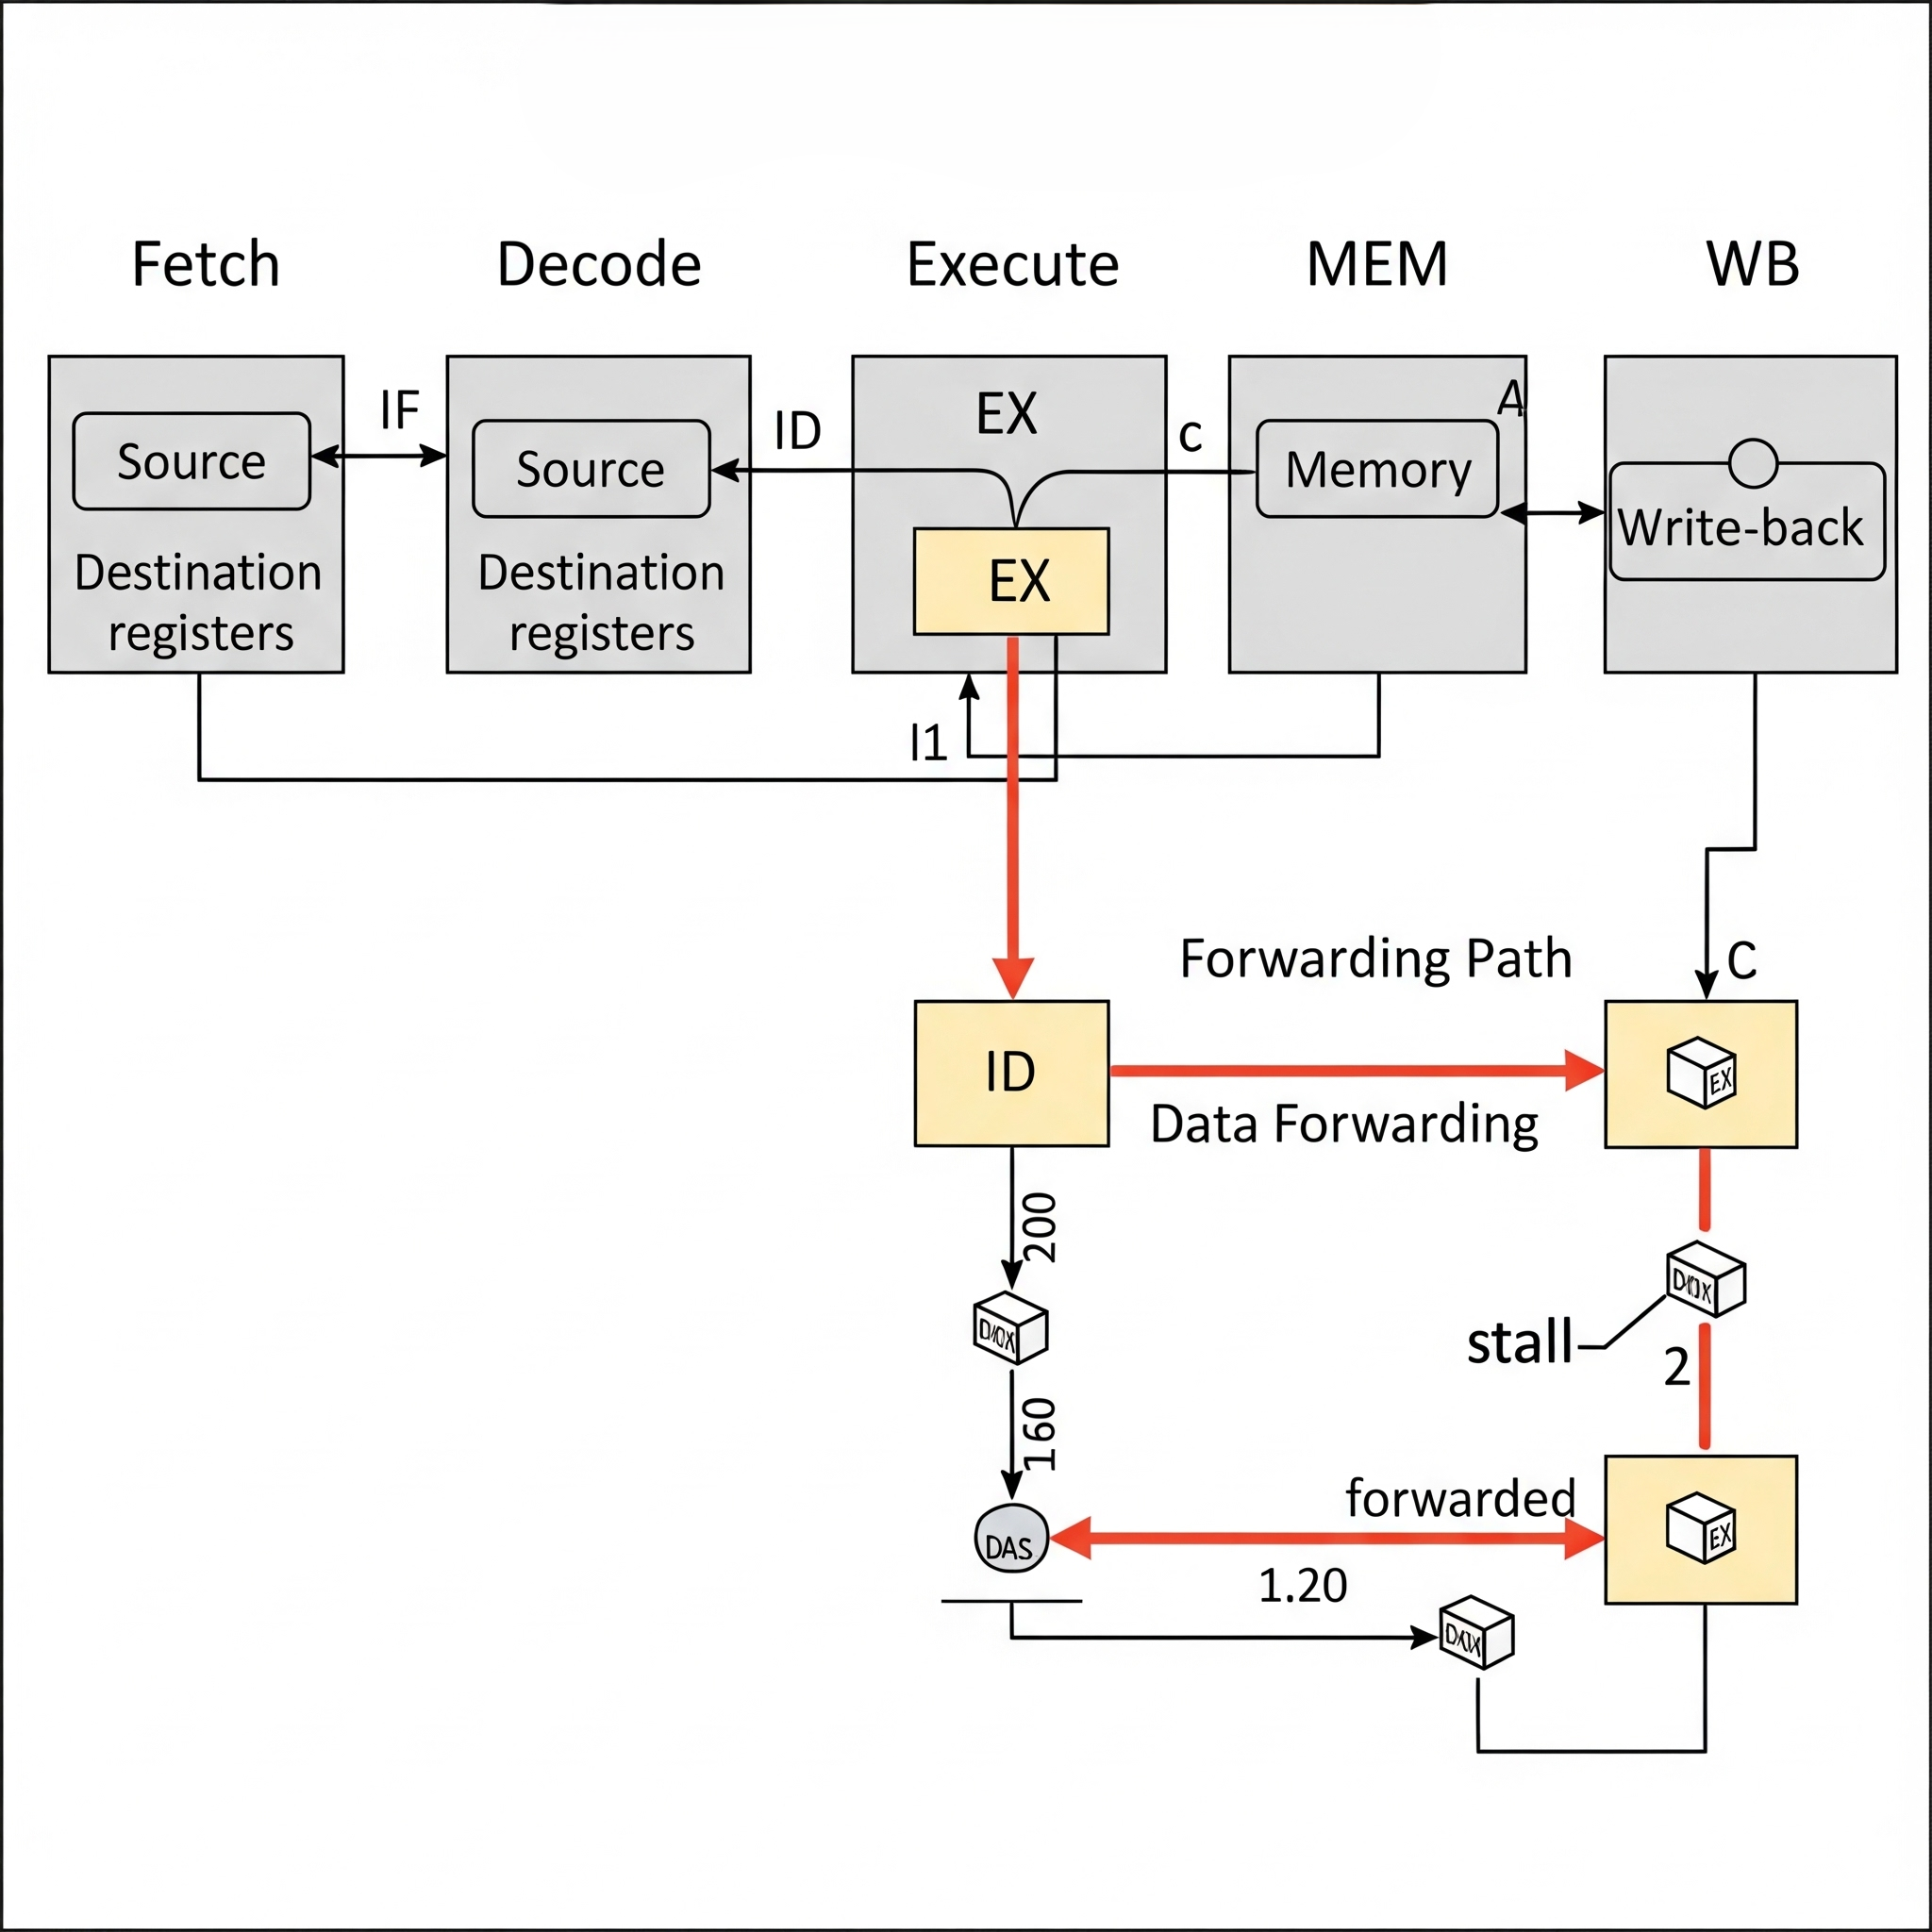
How we are going to develop:
Benchmarking:
We will run a suite of benchmark programs (e.g., simple arithmetic operations, data transfer loops) on our simulated pipeline.
Data Collection:
We will measure key performance metrics for two scenarios:
Pipeline with stalling only.
Pipeline with full forwarding enabled.
Metrics:
The primary metrics will be:
Cycles Per Instruction (CPI)
Total execution time
Number of stalls eliminated.
Analysis:
We will compare the results to quantify the efficiency gains from forwarding.

Slide 5
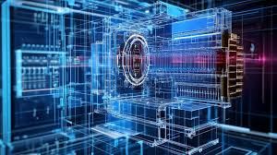
Advantages of our Forwarding technique
Increased Throughput:
By eliminating stalls, more instructions can be completed per unit of time, significantly boosting processor speed.
Reduced Latency:
Instructions that depend on recent results can execute without delay, improving overall program execution time.
Hardware Automation:
Unlike compiler-based solutions, forwarding is a dynamic hardware solution that works for all code without needing recompilation.
Improved Resource Utilization:
The pipeline stages are kept busy, leading to more efficient use of the processor's functional units

Slide 6
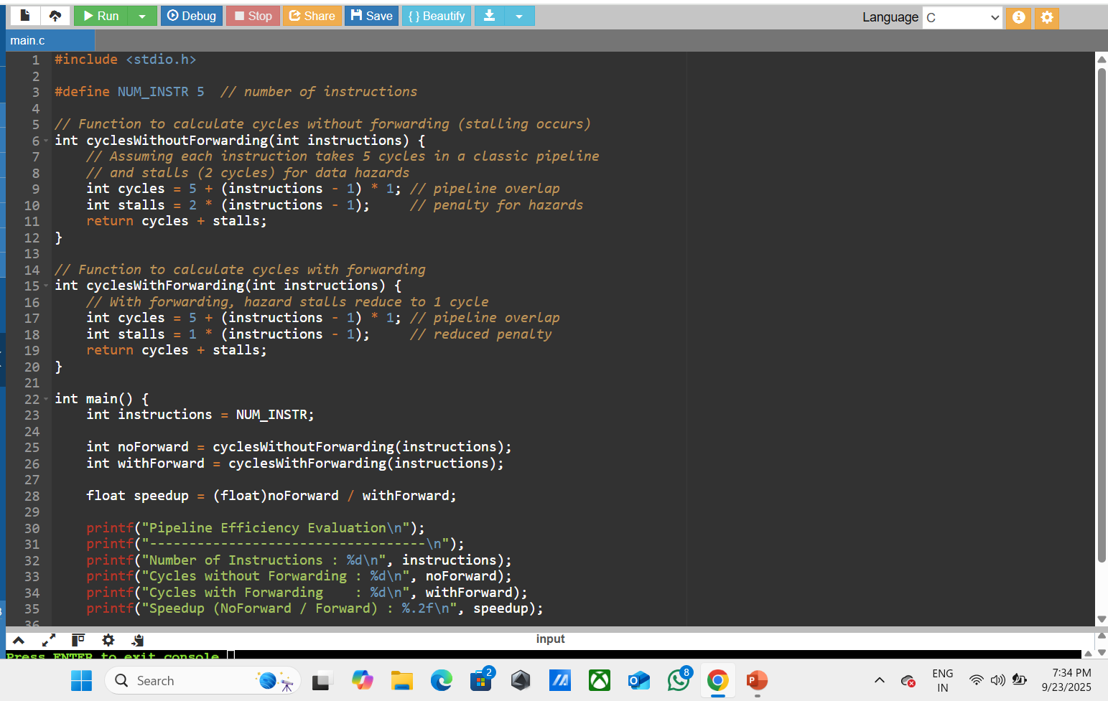
1. C- Program that models instruction execution in a pipeline with and without forwarding, then compares efficiency:

Slide 7
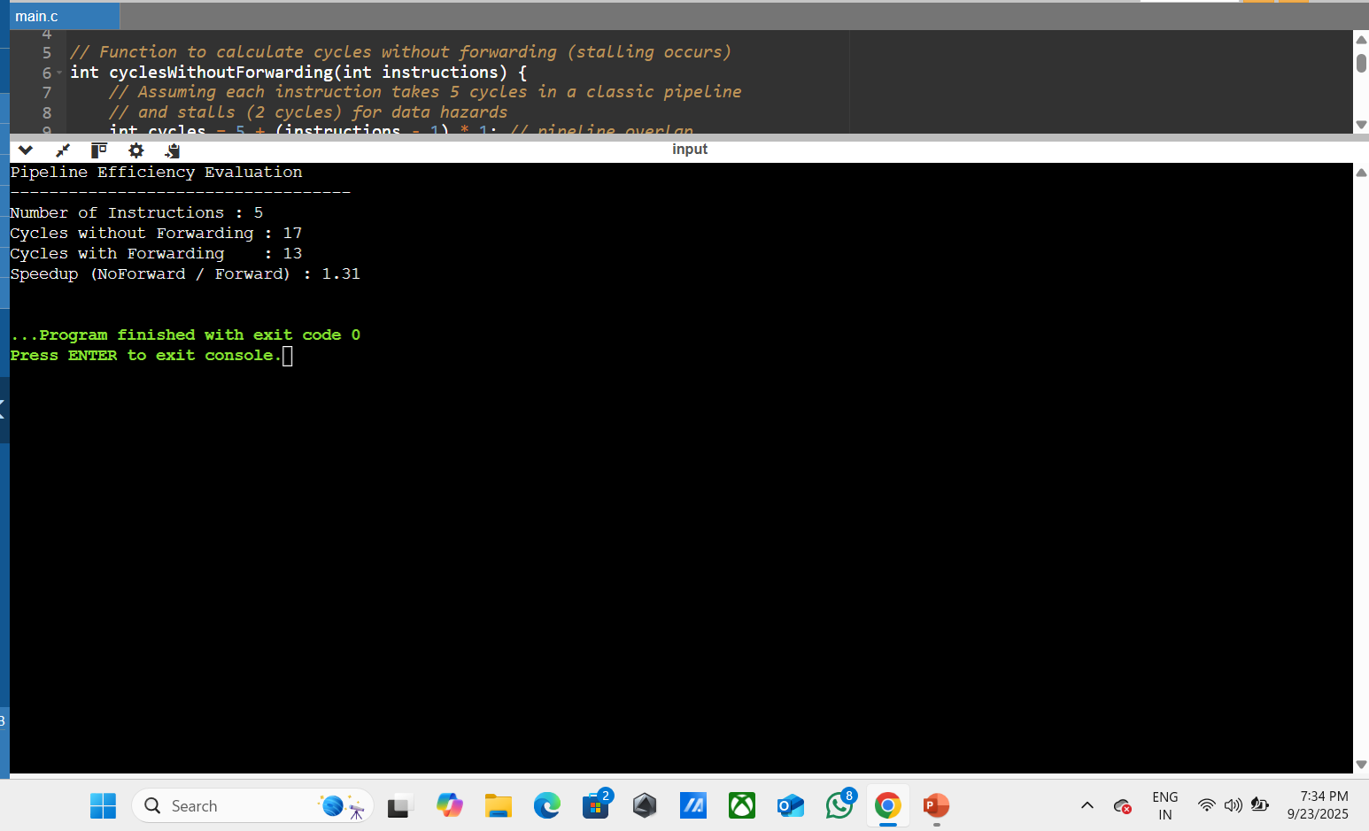
Out put of c- program :

Slide 8

Impacts:
Foundation of Modern Processors:
This evaluation reinforces the critical role forwarding plays in the design of all modern high-performance CPUs.
Performance Scalability:
Understanding forwarding is key to designing deeper pipelines and more complex architectures like superscalar and out-of-order processors.
Educational Value:
This project provides a practical, in-depth understanding of the internal workings of a processor and the challenges of performance optimization.

Slide 9
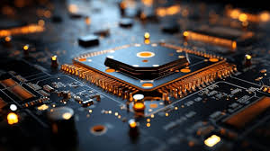
Future Development:
Branch Prediction:
Integrate a branch prediction unit to handle control hazards, further reducing pipeline stalls.
Load-Use Hazard:
Implement logic to handle the specific case of a load instruction followed immediately by an instruction that uses the loaded data, which typically requires one stall even with forwarding.
Superscalar Extension:
Expand the model to a superscalar architecture with multiple pipelines to explore the impact of forwarding in a multi-issue environment.
Power Analysis:
Evaluate the power consumption overhead of the forwarding logic.

Slide 10

Conclusion:
Forwarding significantly reduces pipeline stalls by resolving data hazards efficiently.
It enhances CPU throughput and overall instruction execution speed.
Compared to stalling, forwarding ensures better utilization of pipeline stages.
Effective forwarding techniques bridge the gap between theoretical and practical pipeline performance.
Future improvements in forwarding mechanisms can further optimize modern processor architectures.

Slide 11


